Slide 1

Core
Tin Bui
Dec. 2014

Slide 2
Agenda
Inner Classes
Access Specifiers and Modifiers
Method
Enum
Generic
Annotation

Slide 3
Agenda
Event Handling
Exceptions
I/O Streams
Multi-threading
Java Conventions
Javadoc

Slide 4
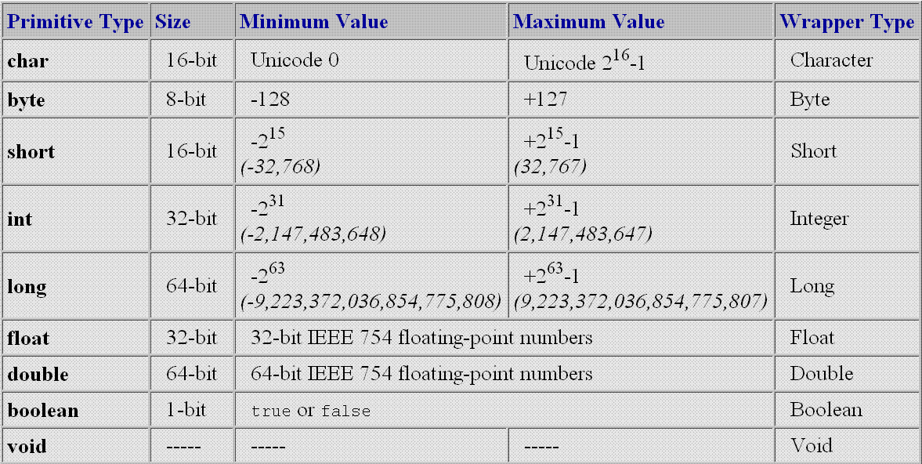
Primitive data type
Every data type in java is class except:

Slide 5
Covariant
Override method - return type
class Alpha {}
class Beta extends Alpha {}
class A {
Alpha doStuff(char c) {
return new Alpha();
}
}
class B extends A {
Beta doStuff(char c) { // legal override in Java 1.5
return new Beta();
}
}

Slide 6
Covariant
Override method - throws declaration
class AlphaException extends Exception {}
class BetaException extends AlphaException {}
class A {
void doStuff(char c) throws AlphaException {
//...
throw new AlphaException();
}
}
class B extends A {
void doStuff(char c) throws BetaException {
// ...
throw new BetaException();
}
}

Slide 7
Inner Classes
Classes defined inside another class or its method
Also called Nested Classes
class MyOuter {
private int x = 7;
class MyInner {
public void seeOuter() {
System.out.println("Outer x is " + x);
}
}
}

Slide 8
Inner Classes
Non-static Inner classes
Can access members of the outer class's instance
Can be instantiated outside by
Or
Static Inner classes
Can be access from outside as an individual class
Can be instantiated outside by
Outer o = new Outer();
Outer.Inner in = o.new Inner();
Outer class play a role as a name space
Outer.Inner in = new Outer().new Inner();
com.abc.xyz.Outer.Inner in = new com.abc.xyz.Outer.Inner();

Slide 9
Inner Classes
OuterClassName.this
Access this pointer of the outer class when you are in the inner class
static
Use this modifier to make the inner class accessible outside the outer class as an individual class

Slide 10
Anonymous Class
A class defined inline without name
Name of the interface or super class of this class
void createForm2(final int formType) {
JButton b = new JButton();
b.addActionListener(new ActionListener() {
public void actionPerformed(ActionEvent e) {
System.out.println("Clicked me!");
}
});
}

Slide 11
Access Specifiers and Modifiers
final
Used for class, fields, methods, parameters or variables
static
Used for inner class, members
Static initialization block: used to deal with static stuffs
synchronized
native
...

Slide 12
Initialization Blocks
class SmallInit {
static int x;
int y;
static { x = 7 ; } // static init block
{ y = 8; } // instance init block
}

Slide 13
Method
Java always pass by value
For reference types it is the address of the passed object
Side effect
Change value of a reference
...: variable argument
Nearly the same as array argument

Slide 14
Method
x.getText() → a
class Test {
JButton x = new JButton("Button x");
JButton y = new JButton("Button y");
JButton z = new JButton("Button z");
JButton t = new JButton("Button t");
public void change(JButton a, final JButton b, JButton c) {
a.setText("a"); // (1)
b.setText("b"); // (2)
b = new JButton("new b"); // (3)
c = new JButton("c"); // (4)
t = new JButton("new t"); // (5)
}
public void testChange() {
change(x, y, z);
}
}
y.getText() → b
Causes compile error because final reference can not be reassigned
Not affect to z
Affect to t
What happen after this method is called?

Slide 15
Enum
Basic enum
public enum WeekDay {
SUNDAY, MONDAY, TUESDAY, WEDNESDAY,
THURSDAY, FRIDAY, SATURDAY
}

Slide 16
Enum
Advanced Enum
public enum Planet {
MERCURY (3.303e+23, 2.4397e6),
VENUS (4.869e+24, 6.0518e6),
EARTH (5.976e+24, 6.37814e6);
public static final double G = 6.67300E-11;
public final double mass; // enum's member is usually final
public double radius;
Planet(double mass, double radius) {
this.mass = mass;
this.radius = radius;
}
public double surfaceGravity() {
return G * mass / (radius * radius);
}
public double surfaceWeight(double otherMass) {
return otherMass * surfaceGravity();
}
}

Slide 17
Enum
Use enum
public static void main(String[] args) {
Planet myPlanet = Planet.VENUS;
System.out.println("Mass: " + myPlanet.mass);
System.out.println("Gravity: "
+ myPlanet.surfaceGravity());
}

Slide 18
Enum
The enum declaration defines a class
Consist of a fixed set of constants.
Can implement interfaces
Can include methods and other fields
Compiler adds some special methods
E.g. values()
Cannot extend any class
Because implicitly extend java.lang.Enum

Slide 19
Annotation
Annotation is metadata
Annotation is an @Interface
Each method declaration defines an element of the annotation type

Slide 20
Annotation
Method declarations must not have any parameters or a throws clause
Return types are restricted to
primitives, String, Class, enums, annotations,
And arrays of the preceding types
Methods can have default values

Slide 21
Annotation Type Declaration
public @interface RequestForEnhancement {
int id();
String synopsis();
String engineer() default "unassigned";
String date(); default "unimplemented";
}

Slide 22
Annotation Usage
Example 1
@RequestForEnhancement(
id = 2868724,
synopsis = "Enable time-travel",
engineer = "Mr. Peabody",
date = "4/1/3007"
)
void travelThroughTime(Date destination) { ... }
Example 2
@Copyright("2002 Yoyodyne Propulsion Systems")
public class OscillationOverthruster { ... }

Slide 23
Annotation
Annotations do not directly affect program semantics
But they do affect the way programs are treated by tools and libraries, which can in turn affect the semantics of the running program

Slide 24
Annotation
Annotations can be read from source files, class files, or reflectively at run time
Annotations complement javadoc tags
Annotation is widely used in many framework
e.g. Spring
@Service
class UserServiceImpl implements UserService {
…
}

Slide 25
Java Convention
Refers JavaCodingConventions.ppt

Slide 26
Generic
Refer Java Generic Programming slides

Slide 27
Event Handling
Listen events
Fire events

Slide 28
Listen Events
JButton b = new JButton();
b.addActionListener(new ActionListener() {
public void actionPerformed(ActionEvent e) {
System.out.println("Button Clicked!");
}
});

Slide 29
Fire An Event Steps
Step 1 [Option]: Define an event class extends EventObject
This class contains the event source
Step 2 [Option]: Define an event listener interface extends EventListener
This class declares which event(s) will be fired

Slide 30
Fire An Event Steps
Step 3: Define your class that cause the event(s).
This class must have these methods:
public void add<YourEvent>Listener(<YourEvent>Listener l)
public void remove<YourEvent>Listener(<YourEvent>Listener l)
protected void fire<YourEvent1>()
...
protected void fire<YourEventn>()

Slide 31
Raise Event - Example
Event object class
public class MyEventObject extends EventObject {
public MyEventObject(Object source) {
super(source);
}
}

Slide 32
Raise Event - Example
Event listener interface
public interface MyEventListener extends EventListener {
void myEvent1Happened();
void myEvent2Happened();
}

Slide 33
Raise Event - Example
Class which causes the event
public class Raiser {
private List<MyEventListener> myEventListeners
= new ArrayList<MyEventListener>();
public void addMyEventListener(MyEventListener l) {
myEventListeners.add(l);
}
public void removeMyEventListener(MyEventListener l) {
myEventListeners.remove(l);
}
protected void fireMyEvent1Happened() {
for (MyEventListener l : myEventListeners) {
l.myEvent1Happened();
}
}

Slide 34
Raise Event - Example
Class which causes the event (cont.)
protected void fireMyEvent2Happened() {
for (MyEventListener l : myEventListeners) {
l.myEvent2Happened();
}
}
public void aMethod() {
long time = System.currentTimeMillis();
if (time % 100 == 0) {
fireMyEvent1Happened();
}
if (time % 1000 == 0) {
fireMyEvent2Happened();
}
}
}

Slide 35
Raise Event - Example
Class listens to the event
public class Handler {
public Handler() {
Raiser r = new Raiser();
r.addMyEventListener(new MyEventListener() {
public void myEvent1Happened() {
System.out.println("Event1 happened");
}
public void myEvent2Happened() {
System.out.println("Event2 happened");
}
});
}
}

Slide 36
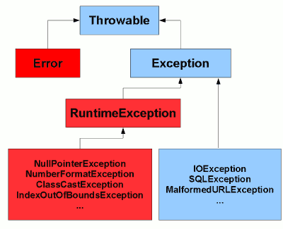
Java Exceptions Hierarchy

Slide 37
Rationale behind the hierarchy
Error subclasses
Represent "serious" errors that a program generally shouldn't expect to catch and recover from
E.g. expected class file being missing, OutOfMemoryError
Exception subclasses (except RuntimeException)
Represent errors that a program can reasonably recover from
RuntimeException
Shouldn't generally expect to occur, but could potentially recover from
Likely to be programming errors rather than invalid user input or a badly configured environment
E.g. ClassCastException, NullPointerException

Slide 38
Checked vs unchecked exceptions
Checked Exceptions
Methods must explicitly declare them
Callers have to handle them explicitly
// Must have try-catch or throws
void caller() // throws FileNotFoundException {
try {
loadFile("abc.txt"); // Must have try-catch or rethrow it
} catch (FileNotFoundException e) { do something }
}
void loadFile(String fileName)
throws FileNotFoundException { // must have throws declaration
if (!(new File(fileName)).exists()) {
throw new FileNotFoundException ("Not exist!");
}
}

Slide 39
Checked vs unchecked exceptions
Unchecked Exceptions
Can be thrown "at any time“
No need to declare
Methods don't explicitly have to declare them
Callers don't have to handle them explicitly
void caller() {
validate("1024"); // No try-catch is required
}
void validate(String s) { // no throws declaration required
if (!isNumber(s)) {
throw new IllegalArgumentException("Not a number");
}
}

Slide 40
Multithreaded Exception Handling
How is exception from another thread handled?
class MyThread extends Thread {
public void run() {
Thread anotherThread = new Thread() {
public void run() {
throw new RuntimeException("Test exception");
}
};
try {
anotherThread.start();
} catch (Exception e) {
System.out.println("Your exception has been caught");
}
}
public static void main(String[] args) {
MyThread t = new MyThread();
t.start();
}
}
Any Exception caught?

Slide 41
Multithreaded Exception Handling
Use observer design pattern
class TaskTracker {
public static interface ErrorListener {
void error(Throwable t, Runnable r);
}
private final List<ErrorListener> listeners
= new ArrayList<ErrorListener>();
public Runnable wrap(final Runnable r) {
return new Runnable() {
public void run() {
try {
r.run();
} catch (Throwable t) {
for (ErrorListener el : listeners) {
el.error(t, this);
}
}
}
};
}
public void addListener(
ErrorListener el) {
listeners.add(el);
}
public void removeListener(
ErrorListener el) {
listeners.remove(el);
}
}

Slide 42
Basic I/O Streams
Refers JavaSocketProgramming.ppt

Slide 43
Multi-threading
Refers JavaSocketProgramming.ppt

Slide 44
More Topics
Javadoc
Collection Framework
Java Reflection

Slide 45
Best Practices
Each method should do one thing
Smaller methods are easier to understand
Partition methods to have short parameter lists
Declare variables when you're first ready to use them

Slide 46
Best Practices
Create new variables rather than reassigning old ones
Don't modify parameter variables
Treat side-effects cautiously

Slide 47
References
SCJP Sun Certified Programmer for Java 6 Exam 310-065
http://www.javamex.com/tutorials/exceptions/exceptions_hierarchy.shtml

Slide 48
Thank you!
Q/A

